Slide 1

Pilot Program Menu Tablets Evaluation Findings

Slide 2



Summary
50 customers participated in our test launch
Customers engaged with the newly implemented tablets, as if they were participating in a typical restaurant experience
The customers were sent a digital survey after their experience ended.

Slide 3
Overview
The purpose of this test launch was to measure customer satisfaction and experience.
We wanted to evaluate:
1) The average ticket time for appetizers and entrees
2) The average checkout time
3) How many customers experienced technical issues
4) How accurate the orders were
5) The average wait time

Slide 4
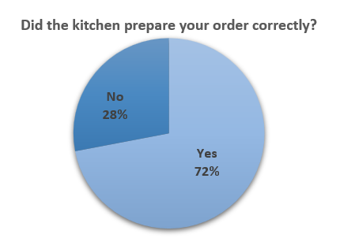
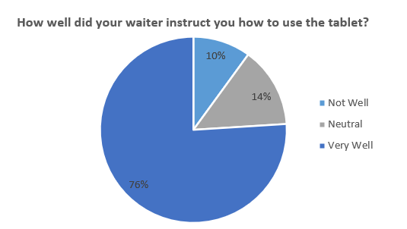
Findings
Expected Accuracy | Actual Accuracy
98% | 72%
Why accuracy lowered?
Wrong item was brought
Not customized as per customer’s request
Over Cooked Food
Substitutes not given as per request

Slide 5
Next Steps
Test the tablets to check if they are sending correct customer request to kitchen. Make sure tablet has the easy navigation and user experience to fill out any requests they have while ordering the food.

Slide 6
Next Steps
Additional training on the tablets for the waitstaff as more than 20% of the customers responded that they were not instructed or were neutral on the use of the tablets. Ensuring that the staff understands how to use the tablets and can properly guide customers on using the tablets can help with this.

